Slide 1

A Deep Dive on Asian Air Quality Index and Future Trend
Group 13
Name | Matric Number | Role
CHEN HUI LIN | 23113750 | Group Leader / Detective
LOONG SHIH-WAI | 24059242 | Detective
WANG SHI BO | 23111363 | Maker
ZHANG YAN WEI | 22102113 | Maker
QIU YIMEI | 23052209 | Oracle / Secretary

Slide 2

01
Project Background and Objectives

Slide 3

Project Background
Exposure to levels of air pollution that pose a significant threat to their health (UNEP ,2019)

Slide 4
Project Background
Project Description:
This project aims to analyse air quality data from the Asian region. The goal is to develop a platform that predicts and visualises the Daily Air Quality Index (DAQI) for Asian countries. This platform will provide accurate insights and decision-making support for policymakers, urban planners, and research institutions, helping them to better understand and manage air quality issues in their respective areas.
Applicable Organisations
Environmental Agencies: UNEP(United Nations Environment Programme (UNEP)), World Health Organization (WHO).
Local Governments: For air quality monitoring and policy development.
Research Institutions: Focused on climate, health, and pollution studies.
Non-Governmental Organisations (NGOs): Such as Greenpeace and Clean Air Asia, advocating for environmental policy change.

Slide 5
Project Objectives
To investigate the correlation between Air quality index and different pollutants.
To generate future air quality prediction model based on existing data set
To provide insights to policymakers on actionable improvement actions

Slide 6
02
Data Acquisition, Scrubbing and Exploration

Slide 7
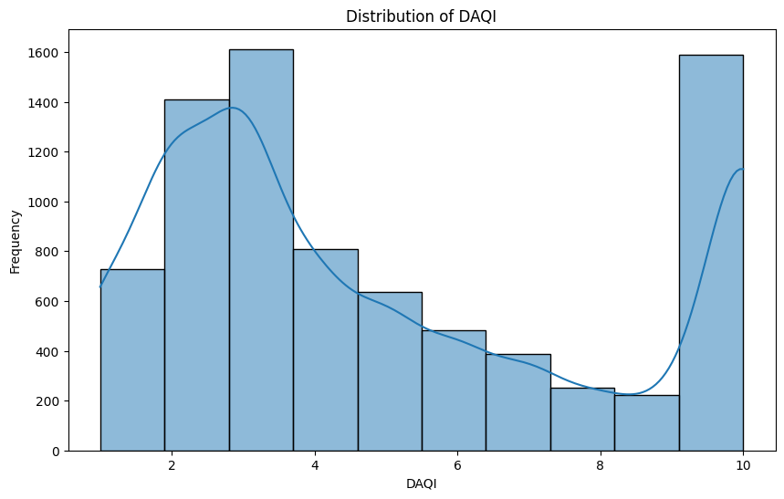

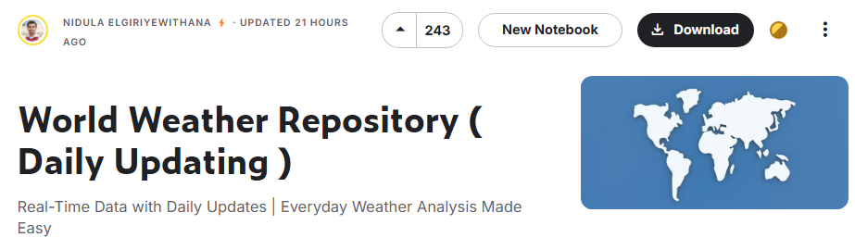
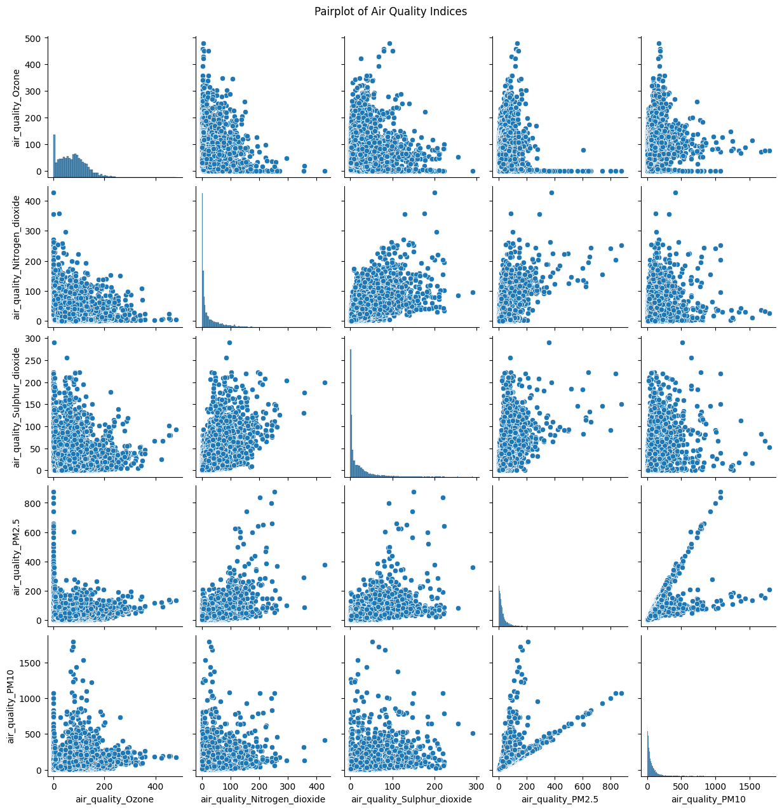
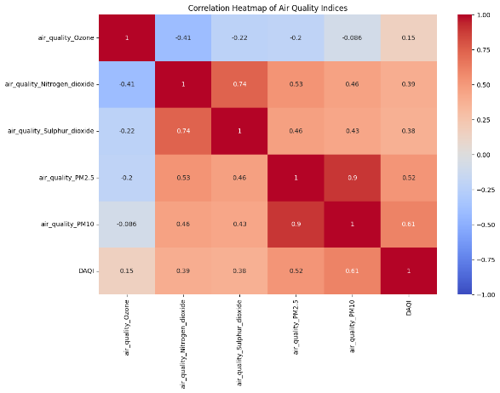
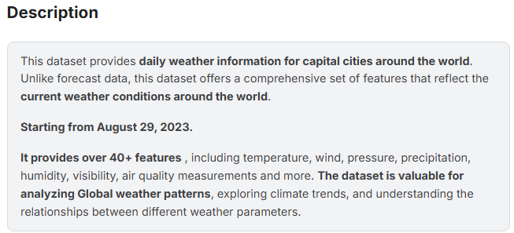
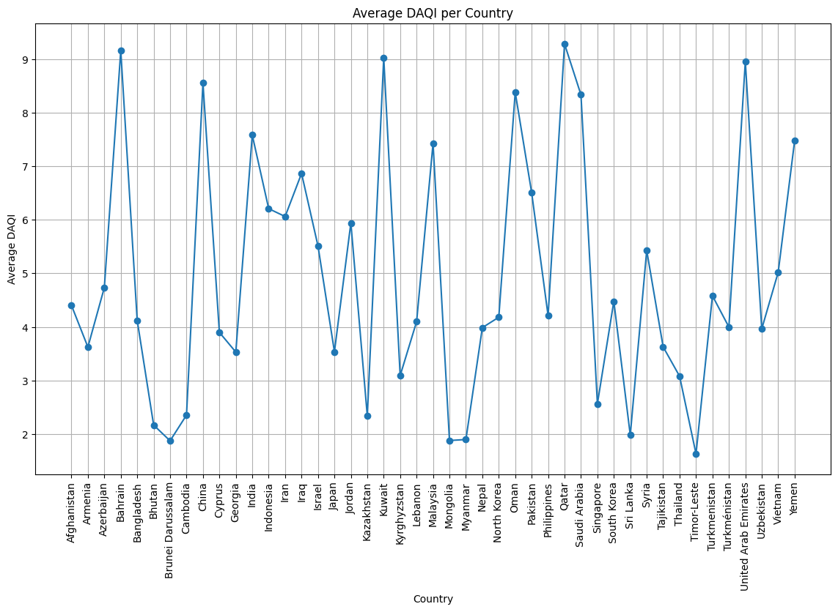
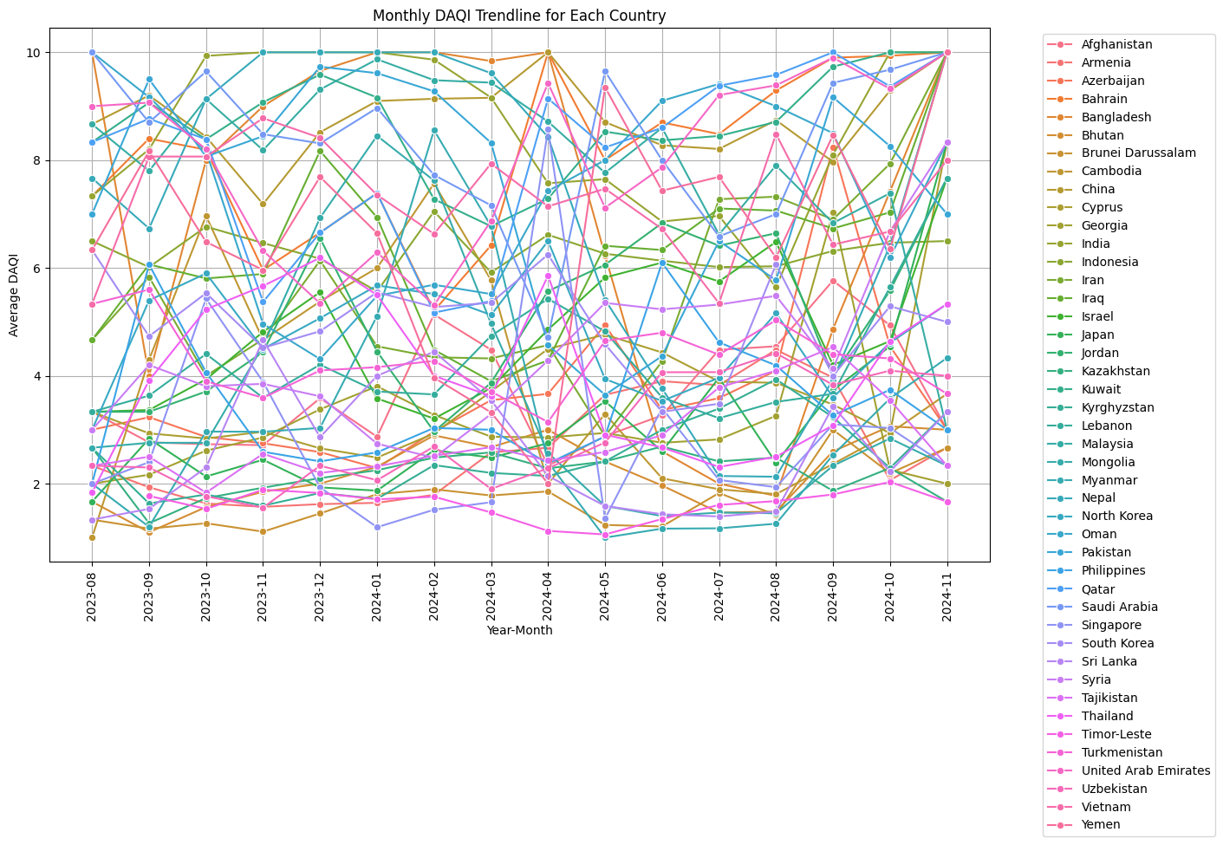
Acquisition
Explore
Distribution of DAQI
Scrub
Pairplot of Air Quality Indices
Correlation Heatmap of Air Quality Indices
Data unrelated to air quality dropped
Data points out of Asia region dropped
Validate data has no nulls / blanks
Further removal of missing data
Standardise date range*
Average DAQI per Country
Monthly DAQI Trendlines for Each Country

Slide 8
03
Modelling

Slide 9
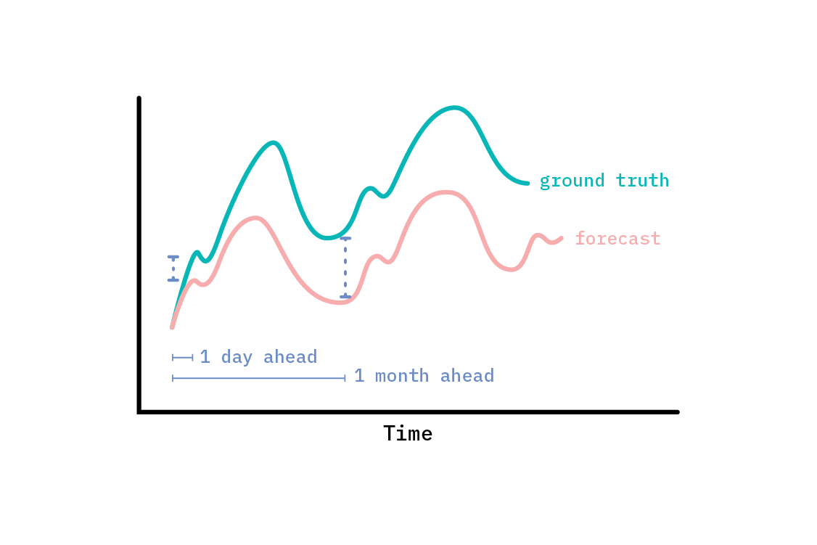


Modeling
Time Series Model – SARIMA & SARIMAX
SARIMA
vs
SARIMAX
Univariate forcasting multivariate forecasting
Why Time Series Modeling?
Since DAQI data is stored in a time-series format with precise timestamps.
Focusing on predicting trends.

Slide 10
Modeling
SARIMA
SARIMAX
Country Selection
Data Splitting
Exogenous Variables
Standardization
Model Building
Evaluation
&
Visualization

Slide 11
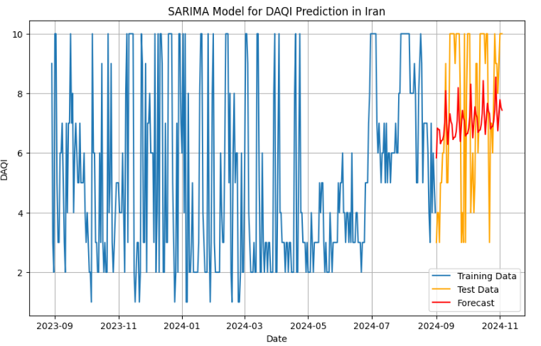
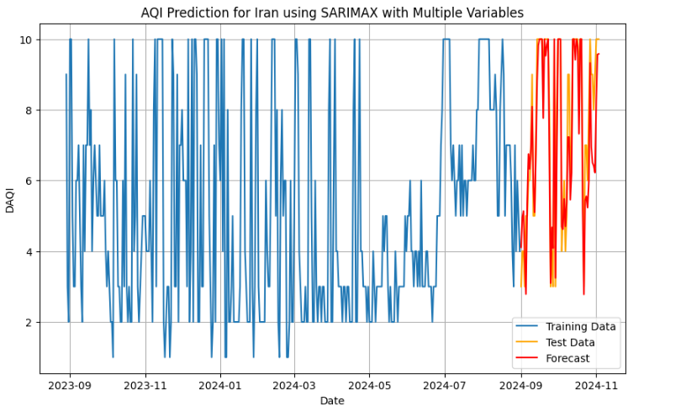
Modeling
Firstly, we choose Iran as the targeted country and evaluate the model.
Single Variable (DAQI) modelling by SARIMA
Multiple Variables (Exogenous variables:PM2.5, PM10, CO2, NO2, OZONE. Target variable: DAQI) modelling by SARIMAX
Mean Absolute Error (MAE): 2.1903480488805216
Mean Squared Error (MSE):6.10505340799592
Root Mean Squared Error (RMSE): 2.470840627801785
Mean Absolute Error (MAE): 0.7313090408735258
Mean Squared Error (MSE): 1.0295556496908054
Root Mean Squared Error (RMSE): 1.0146702172089241

Slide 12
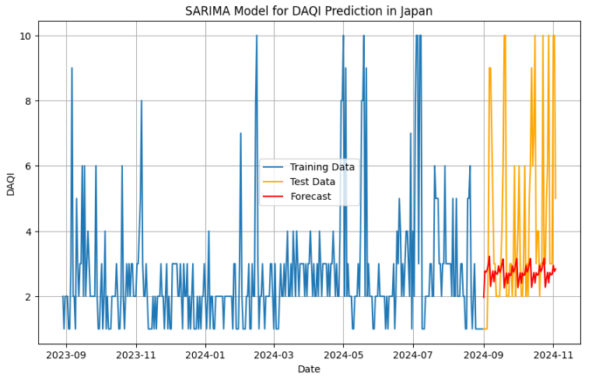
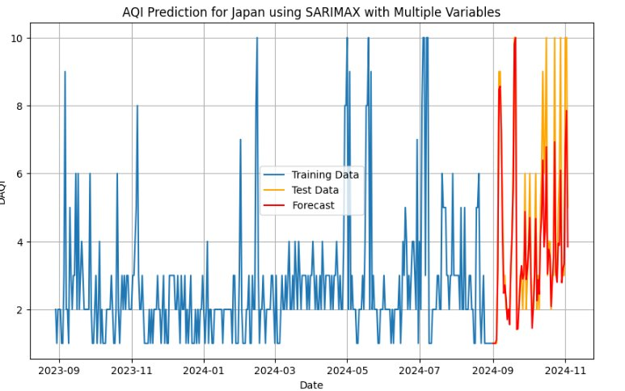
Modeling
Then, we choose Japan as the targeted country and evaluate the model.
Single Variable(DAQI) modelling by SARIMA
Multiple Variables(Exogenous variables:PM2.5, PM10, CO2, NO2, Ozone. Target variable: DAQI) modelling by SARIMAX
Mean Absolute Error (MAE): 2.1677573765634097
Mean Squared Error (MSE): 10.37454919119596
Root Mean Squared Error (RMSE): 3.2209547018230418
Mean Absolute Error (MAE): 0.7295534865871702
Mean Squared Error (MSE): 1.3910988655989314
Root Mean Squared Error (RMSE): 1.179448543005981

Slide 13
Modeling
Using historical exogenous variables to forecast future pollutant levels with the Prophet model, which are then input into the SARIMAX model to predict future DAQI values.
Historical exogenous variables(PM 2.5, PM10 etc.)
Prophet
Forcasted variables(PM2.5, PM10 etc.)
SARIMAX
Prediction

Slide 14
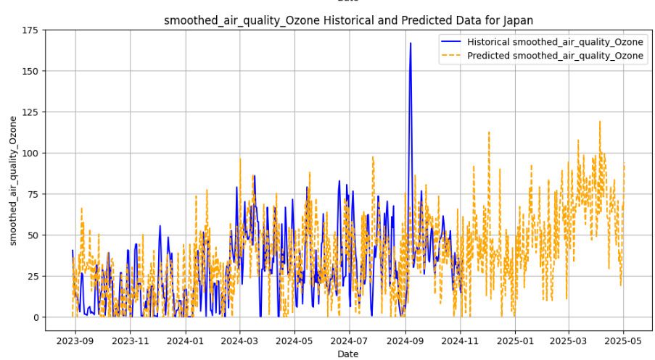
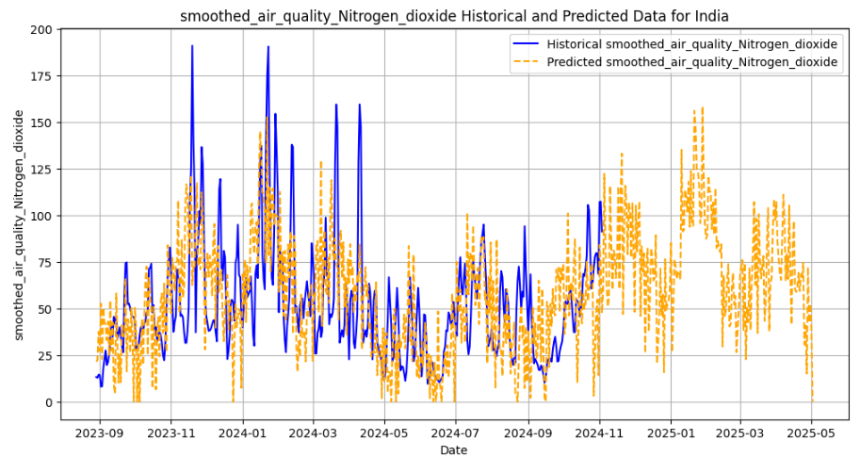
Modeling
Involving Prophet for exogenous variable forecasting

Slide 15
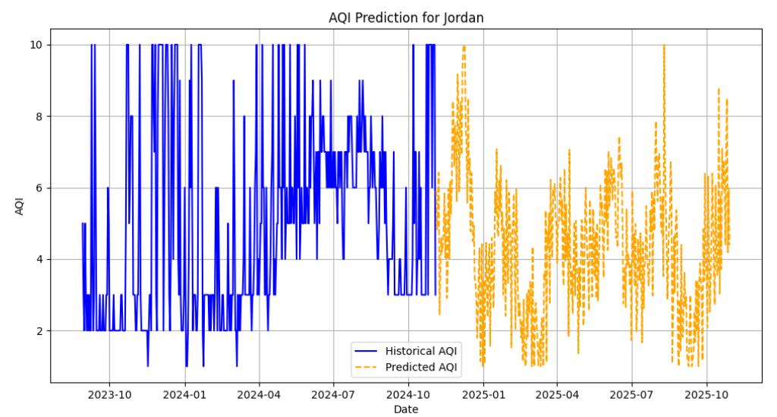
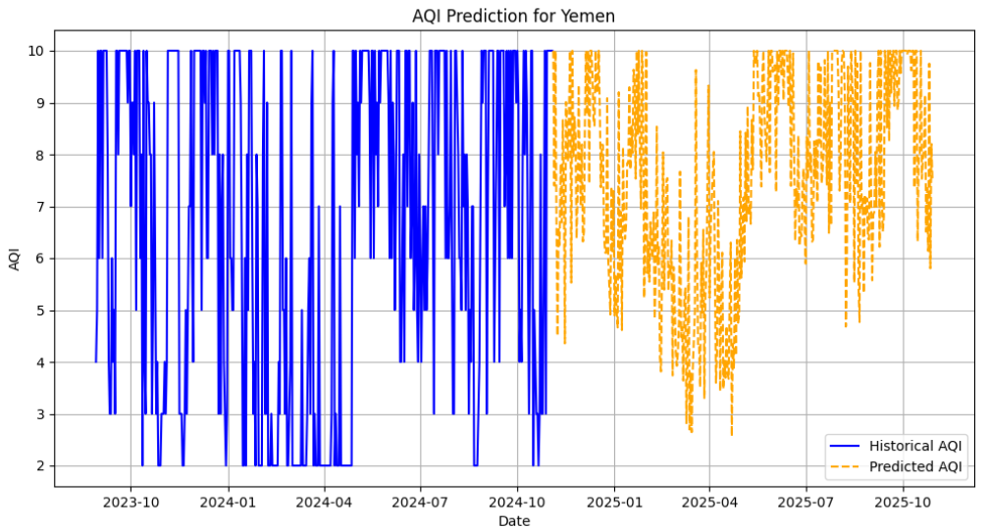
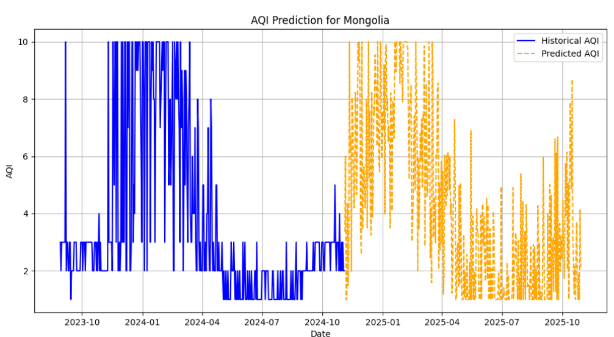
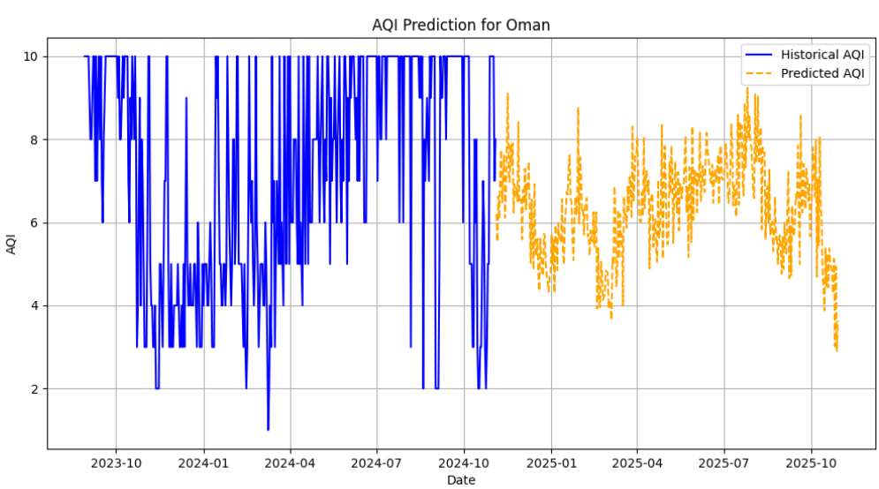
Modeling
Prediction Results

Slide 16
04
Data Interpretation

Slide 17
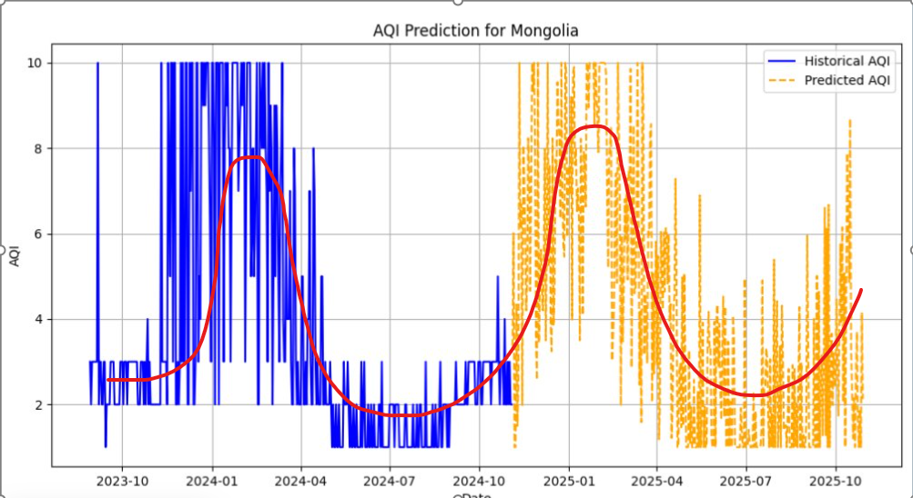
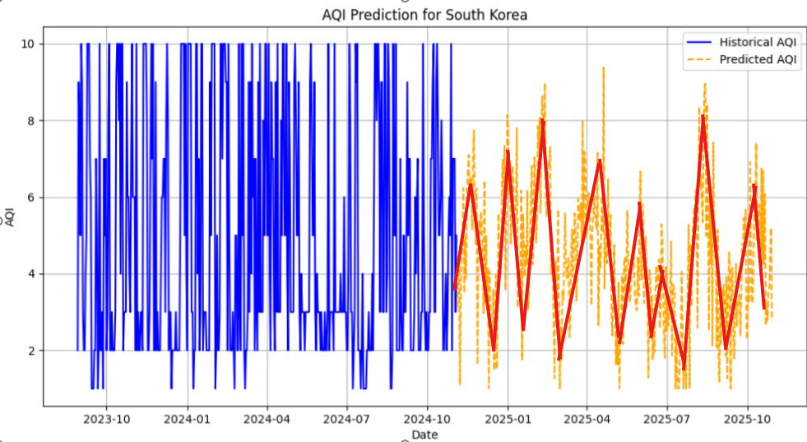
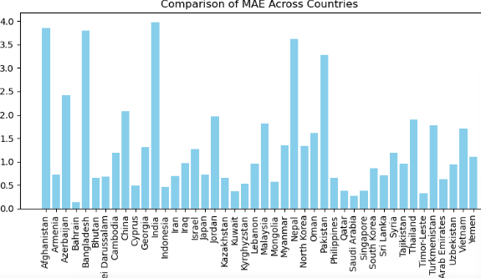
Data ​Interpretation
Some countries show clear seasonal fluctuations(e.g. Mongolia)
Some countries fluctuate more randomly(e.g. South Korea)
Country models with MAE less than or equal to 1.5 are good representatives of SARIMAX models that capture AQI trends and seasonal patterns in most countries.
For countries with high MAE, we may need to introduce more external variables such as temperature, humidity, and traffic conditions. Industrial emissions

Slide 18
05
Plan for Reproducible Research

Slide 19
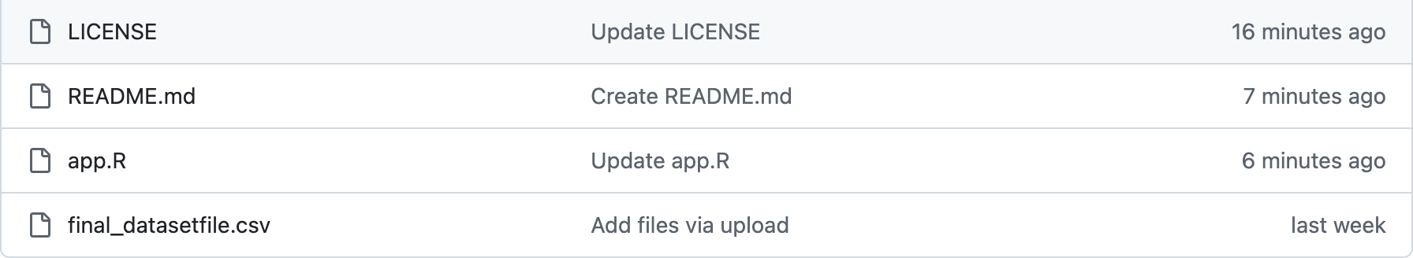
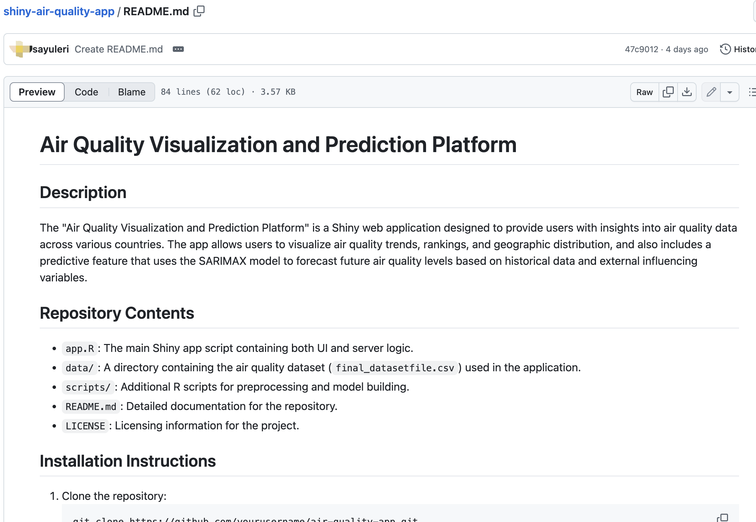
Plan for Reproducible Research
Code and Data Availability
Hosted on a public GitHub repository.
Includes scripts for data preprocessing, analysis,
and visualization.
Enables replication of workflows.
(https://github.com/sayuleri/shiny-air-quality-app)
(https://github.com/sayuleri/shiny-air-quality-app/blob/main/final_datasetfile.csv)
2. Documentation
Comprehensive documentation available in GitHub.
README file includes objectives, dependencies,
and usage instructions.
(https://github.com/sayuleri/shiny-air-quality-app/blob/main/README.md)

Slide 20
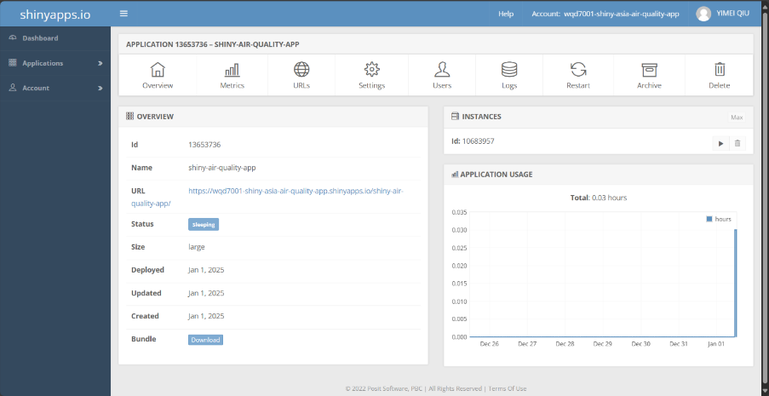



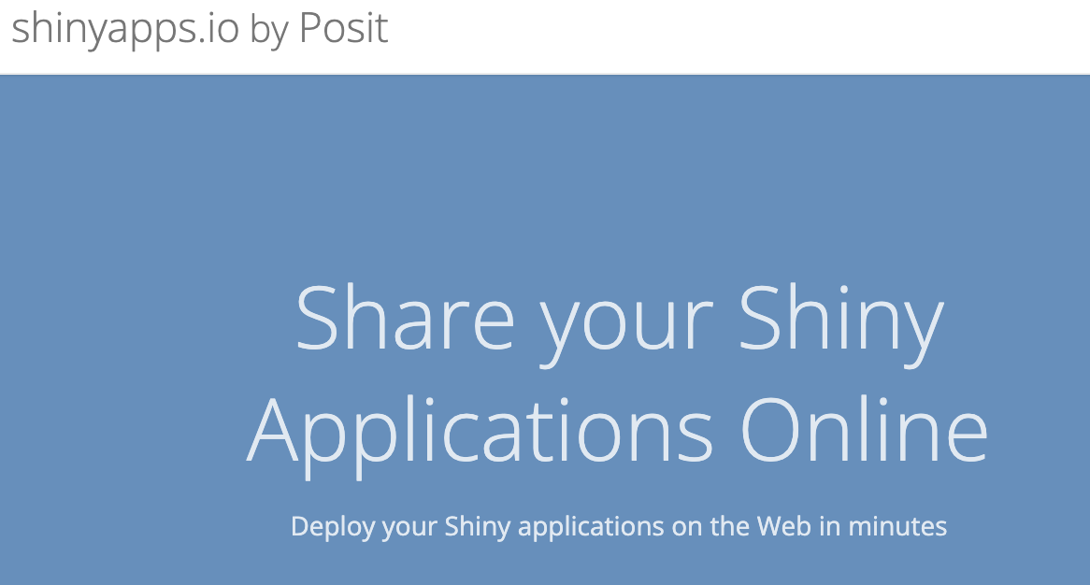

Plan for Reproducible Research
3. Public Deployment
Interactive Shiny app deployed on ShinyApps.io.----
(https://WQD7001_shiny_Asia_air_quality.io/app-name/)
Accessible without local software installation.
4. Data Accessibility
Public datasets cited with instructions for access.(https://www.
kaggle.com/datasets
/nelgiriyewithana/global-weather-repository?resource=download)
Proprietary data replaced with simulated or anonymized datasets.
5. Open-source Tools
Exclusively uses open-source tools : Python, R, Rstudio
Exclusively uses open-source libraries: R – shiny, ggplot2, dplyr, readr, leaflet, tidyr, forecast, scales;
Python – pandas, matplotlib.pyplot, seaborn
Reproducible without proprietary software: shiny，shinyapp.io

Slide 21
06
Deployment of Data Product

Slide 22
Deployment of Data Product
Step 1: Prepare GitHub Repository
Create a GitHub Repository:
Log in to GitHub, create a new repository, and set it to Public or Private.
name: shiny-air-quality-app.
2. Set up Locally:
mkdir shiny-air-quality-app cd shiny-air-quality-app Add app.R and final_datasetfile.csv to this folder.
3. Push to GitHub:
git init git add . git commit -m "Initial commit for Shiny app" git branch -M main git remote add origin https://raw.githubusercontent.com/sayuleri/shiny-air-quality-app/main/final_datasetfile.csv git push -u origin main

Slide 23
Deployment of Data Product
Step 2: Deploy Application Online
Install and Configure rsconnect:
Install the package(R):
install.packages("rsconnect") library(rsconnect)
2. Set up your ShinyApps.io account(R):
rsconnect::setAccountInfo(name='wqd7001-shiny-asia-air-quality-app', token='0D8468C90313D9129898F79C6B676137', secret='secret')
3. Deploy the Application:
Ensure app.R and final_datasetfile.csv are in the same folder.
Run the deployment command in R:
rsconnect::deployApp("~/shiny-app/")
4. Access the Application:
After deployment, ShinyApps.io provides a URL:
https://wqd7001-shiny-asia-air-quality-app.shinyapps.io/shiny-air-quality-app/

Slide 24
Deployment of Data Product
Step 3: Post-Deployment Maintenance
Manage Data Files:
Use relative paths to access data(R):
github_url <- "https://raw.githubusercontent.com/sayuleri/shiny-air-quality-app/main/final_datasetfile.csv"
data <- read.csv(github_url)
Monitor Logs:
Debug and check performance via ShinyApps.io's Logs feature.
3. Update Applications:
Redeploy when changes are made(R):
rsconnect::deployApp("~/shiny-app/")
Push updates to GitHub:
git add . git commit -m "Updated app features" git push origin main

Slide 25
07
Insights and Conclusion

Slide 26
Insights and Conclusion
Insights:
SARIMA model performance struggled with dynamic fluctuations.
SARIMAX model, incorporating exogenous variable adapts and aligns better to the test data.
Model performance still has variance when ran across multiple different countries, showing benefits of incorporating more dynamic variables.
Conclusion
The prediction:
Indicates concerning decline in future air quality.
Emphasise the urgent need for robust, actionable strategies to alter this path.
Future iterations of the model could benefit from incorporating more dependent variables.

Slide 27
08
References

Slide 28
References
DEFRA. (n.d.). UK Air Quality Annual Report. Department for Environment, Food & Rural Affairs (DEFRA). Retrieved from https://uk-air.defra.gov.uk/library/annualreport/index
Huang, Y., Zhang, J., & Sun, Y. (2024). Analysis of AQI and its impacts. Environmental Toxicology and Pharmacology, 58, 18-29. https://doi.org/10.1007/s40201-024-00900-6
Liu, J., & Zhang, Z. (2020). Air quality monitoring using IoT technologies. IEEE Access, 8, 12345-12356. https://doi.org/10.1109/ACCESS.2020.2993478
Manchanda, R., & Sharma, M. (2024). Air pollution control technologies. Science of the Total Environment, 730, 138320. https://doi.org/10.1016/j.scitotenv.2020.138320
Aeroqual. (2024). Understanding Air Quality Index (AQI). Aeroqual. Retrieved from https://www.aeroqual.com/blog/air-quality-index

Slide 29
References
Zhang, L., & Xu, W. (2024). Air pollution control in industrial sectors. Journal of Environmental Management, 275, 111314. https://doi.org/10.1016/j.jenvman.2020.111314
Gupta, R., & Singh, P. (2024). Effects of urban traffic on air quality in metropolitan cities. Science of the Total Environment, 731, 138127. https://doi.org/10.1016/j.scitotenv.2020.138127
Wang, Y., & Li, F. (2024). Air pollution control strategies in agricultural areas. Environmental Pollution, 265, 114385. https://doi.org/10.1016/j.envpol.2020.114385
Zhang, L., & Yu, S. (2024). Reducing air pollution from vehicle emissions. Science of the Total Environment, 730, 138320. https://doi.org/10.1016/j.scitotenv.2020.138320
Wang, J., & Li, X. (2024). Evaluation of air quality in urban areas. Environmental Toxicology and Pharmacology, 56, 24-34. https://doi.org/10.1016/j.etap.2020.110213

